Slide 1
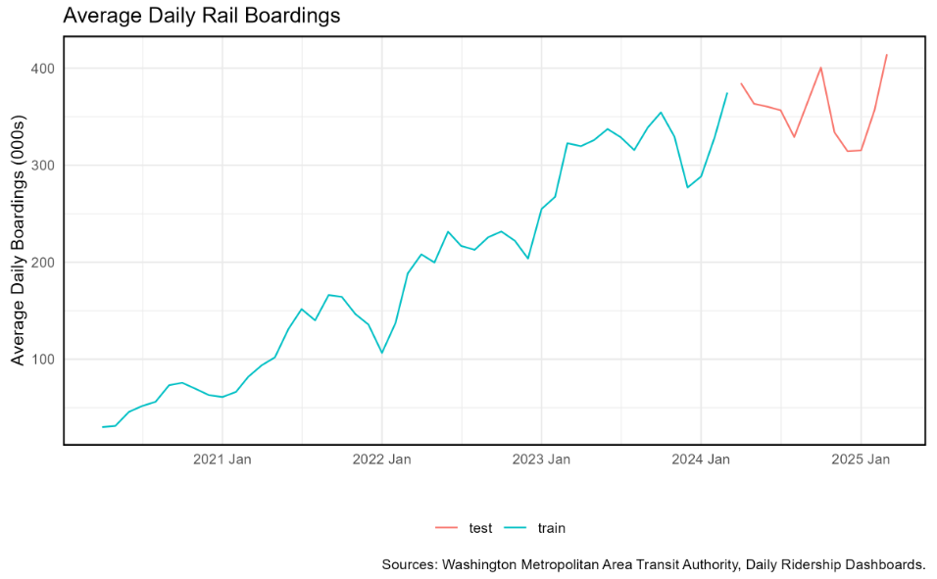
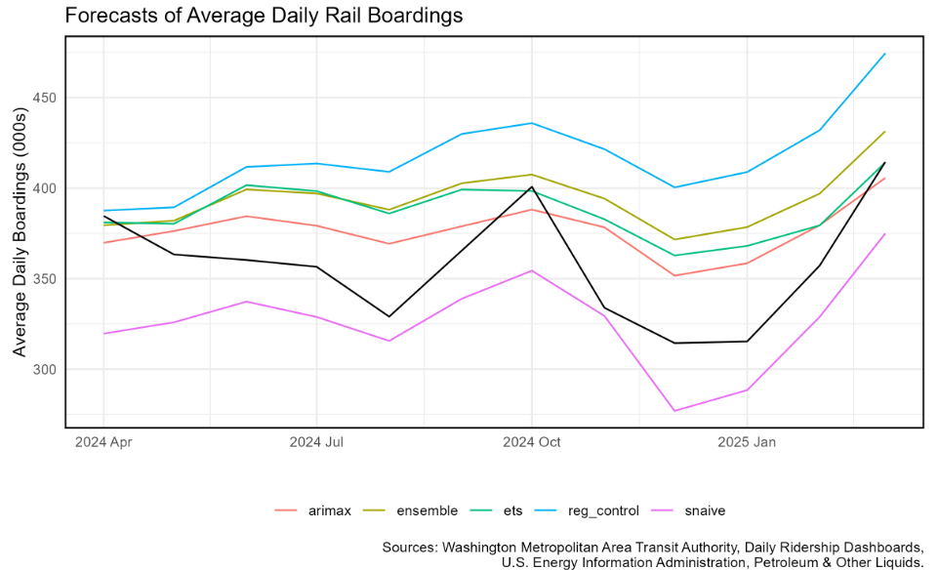
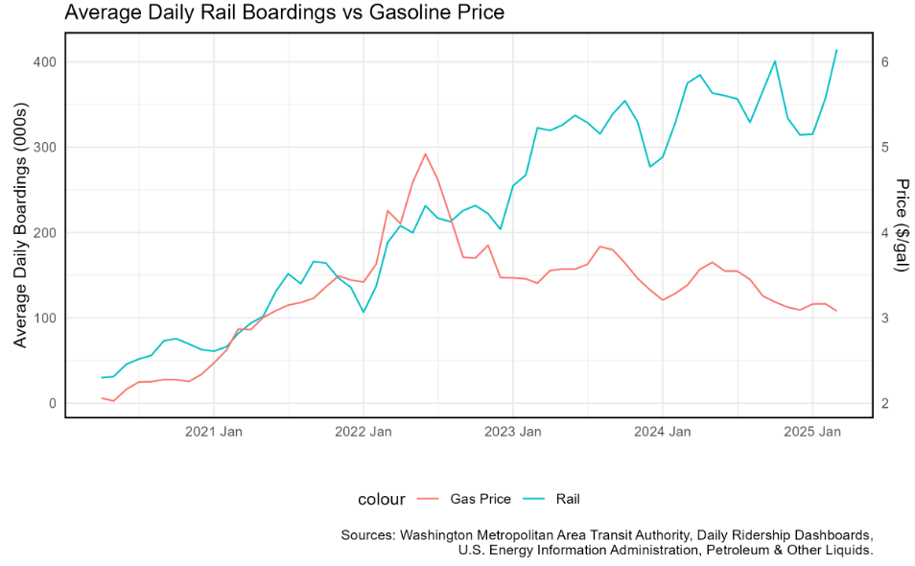
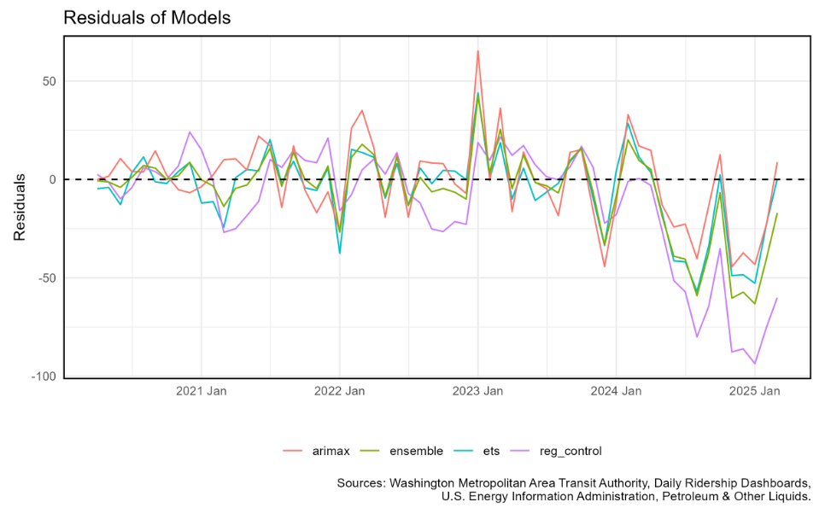
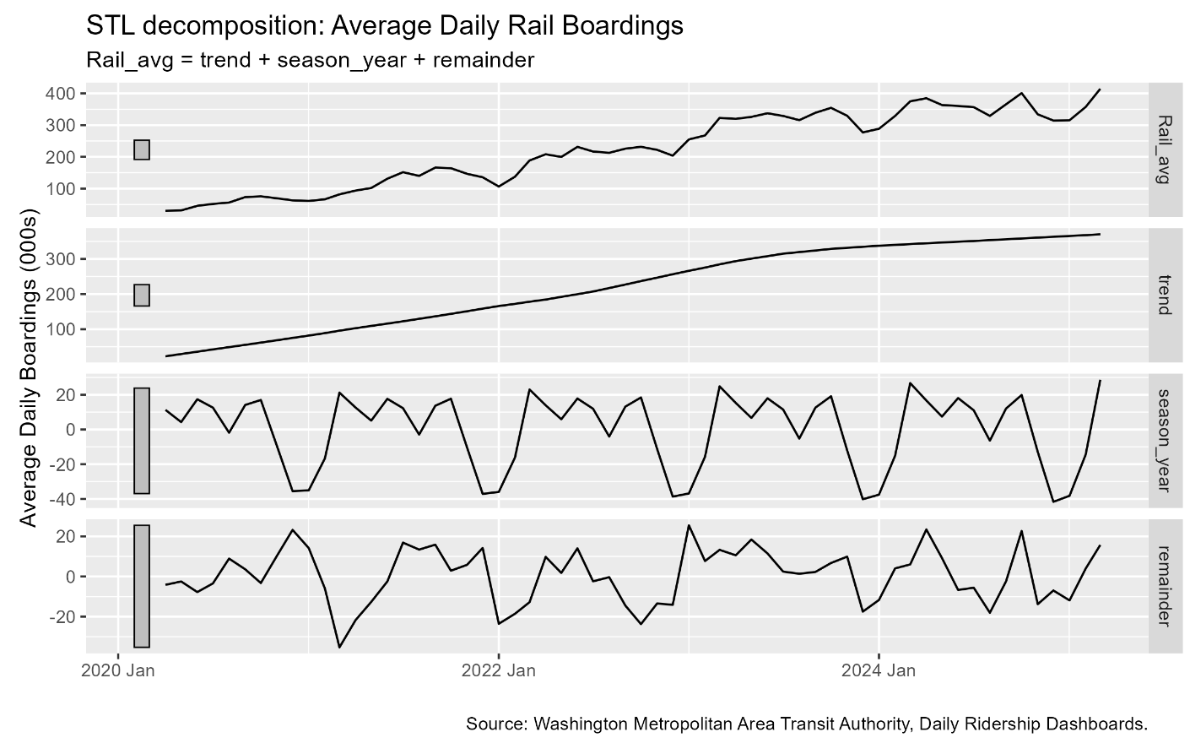
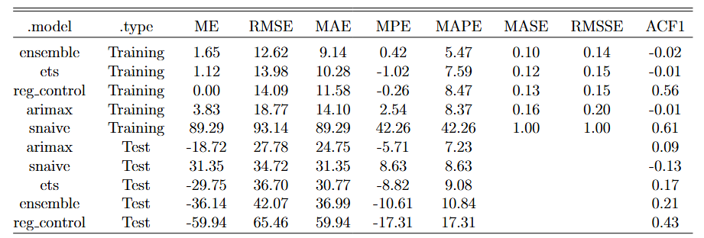

Forecasting the Post-COVID Recovery of Washington DC Public Transportation Usage
Steven VanOmmeren Boston College
Abstract
The COVID-19 lockdowns of early 2020 saw the use of public transportation plummet. Since lockdown restrictions have loosened, the use of public transportation has slowly increased and in some cases exceeds pre-pandemic levels. Residents of the DC-Maryland-Virginia (DMV) area heavily rely on Washington DC's public rail system, run by the Washington Metropolitan Area Transit Authority (WMATA). I use daily ridership data provided by WMATA to analyze rail transport usage from March 2020 through March 2024. I then make predictions of average daily ridership for April 2024 through March 2025. I use a range of statistical models and compare their predictive accuracy, finding that ridership can be reasonably predicted using simple models. I also compare my model predictions with WMATA's budget forecasts.
Methods
Data
I use two sources of data:
• Daily rail boardings in Washington DC (Source: WMATA)
I average to the monthly level.
• Monthly average consumer gasoline prices (Source: U.S. EIA)
This yields 60 observations (5 years of monthly data).
I split the data into training and test subsets, with the first 48 months used as training data.
Analysis
I test 5 predictive models of average daily train rides:
• Seasonal Naïve
• ETS: includes a damped-additive trend component and additive seasonal component.
• TS Regression: regress Rides on gas price, seasonal indicators, and a piecewise-linear trend with knots at Jan. 2021, Jan. 2022, Jan. 2023, and Jan. 2024.
• ARIMAX: includes gas price as an exogenous regressor.
• Ensemble: a simple average of the ETS, TS Regression, and ARIMAX models.
Results
Subheader
Totat ullaborernam harci cus, cuscidendit lat et as eum explit apicaboria am que vendent inullup tatur? Quia voluptat ut prae. Qui blatibu saecture, ut volor as a audae es elenti quis qui tessum faccuptatet odignisim eatur, sincia nusdantent estem haruntiatint idit rem ulpa et exped que provitatatur seque pro idi nos quid quo vent.
Quia voluptat ut prae. Qui blatibu saecture, ut volor as a audae es elenti quis qui tessum faccuptatet
Suggested format for numbered list:
Auditius
dolupta tatumquae
Auditius
nusdantent
nonsectius re sumque
Uciam que nit vit etusand andam, torae consequam haruntis et hiciisi nonsectius re sumque.
Discussion
Subheader
Content goes here: Ossus volupicabore et iminciae nitati diaeculpa cumquo omnihil et, occulpa venient ab ilibusam volectes vellic tori sitiusam inciis net voluptatiis auditius dem venimus, ium eatius dolupta tatumquae num eos im fugitis ipienimet estisit, que con nonsequi culluptia as dis consequatem qui aliqui doluptatum est, od quo blab ilias eum exeres delitem qui ipiti omnisquam harchic temper.
Ossus volupicabore et iminciae nitati diaeculpa cumquo omnihil et, occulpa venient ab ilibusam volectes vellic tori sitiusam inciis net voluptatiis auditius dem venimus, ium eatius dolupta
Subheader
Ossus volupicabore et iminciae nitati diaeculpa cumquo omnihil et, occulpa venient ab ilibusam volectes vellic tori sitiusam inciis net voluptatiis auditius dem venimu, ium eatius doluptaium eatius dolupta tatumquae num eos im fugitis ipienimet estisit, que con nonsequi culluptia as dis consequatem qui aliqui doluptatum.
Variable of Interest, Training and Testing Periods
This is the suggested format for captions.
Duis autem vel eum iriure dolor in hendrerit in vulputate velit esse molestie consequat.
Conclusion
Ossus volupicabore et iminciae nitati diaeculpa cumquo omnihil et, occulpa venient ab ilibusam volectes vellic tori sitiusam inciis net voluptatiis auditius dem venimu, ium eatius doluptaium eatius dolupta tatumquae num eos im fugitis ipienimet estisit, que con nonsequi culluptia as dis consequatem qui aliqui doluptatum.
Introduction & Significance
Forecasting is the prediction of future events using historical information. Accurate forecasts are vitally important to ensuring that appropriate business and government decisions are made. When sufficient data are available, statistical forecasting methods can approximate the time-series behavior of relevant variables using historical data of both the variable of interest and any additional relevant variables that may increase a model's performance. In this paper, I use a variety of statistical forecasting methods, some of which make use of additional control variables, to predict WMATA ridership.
Forecasting long-term ridership patterns is critical to transportation systems. WMATA is required to predict its future costs and revenues in its annual budgets for government approval; revenue predictions require an accurate estimate of future ridership. Additionally, there has been much discussion of the lingering effects of COVID-19 on public transportation usage, and whether the current state is still trending upwards or a “new normal.”
With 5 years passed since the start of COVID-19 lockdowns, we have sufficient data to analyze the post-COVID recovery of train ridership in Washington DC. I analyze the average daily train ridership per month, leaving a prediction of bus rides for future work
Average Ridership vs Gas Prices
This is the suggested format for captions.
Duis autem vel eum iriure dolor in hendrerit in vulputate velit esse molestie consequat.
References
Brey, Jared (2023). “Predicting Future Transit Ridership Is Trickier Than Ever”.
Hoque, Jawad Mahmud et al. (2024). “Are public transit investments based on accurate forecasts? An analysis of the improving trend of transit ridership forecasts in the United States”.
Mucci, Richard A. and Gregory D. Erhardt (2018). “Evaluating the Ability of Transit Direct Ridership Models to Forecast Medium-Term Ridership Changes: Evidence from San Francisco”.
Pinho, Paulo et al. (2024). “The application of direct ridership models in the evaluation of the expansion of the Porto Light Rail Transit”.
STL Decomposition, Rail Ridership
In- and Out-of-Sample Performance Metrics for my models.

